Slide 1

Assignment 3 Optimum size and location of PV using Metaheuristic Algorithm
Submitted by : Ashish Bhatta
Submitted to : Assistant Prof. Dr. Samudra Gurung
February 2025

Slide 2
Objectives
Use two different meta-heuristic optimization algorithms to find the optimal size of Grid-connected solar farm GSFs
Formulate the Objective Function and constraints
Find optimum size of PV
Find optimum location of PV
Compare results between two different algorithm

Slide 3
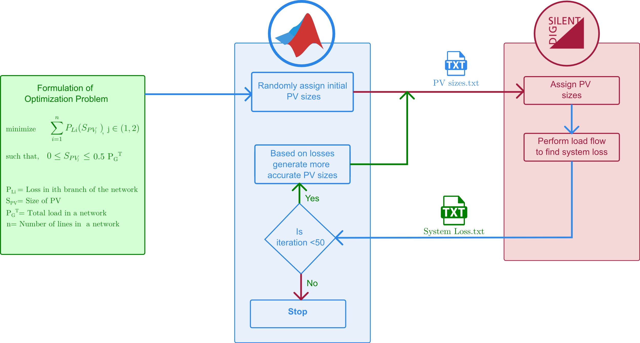
Optimization process

Slide 4
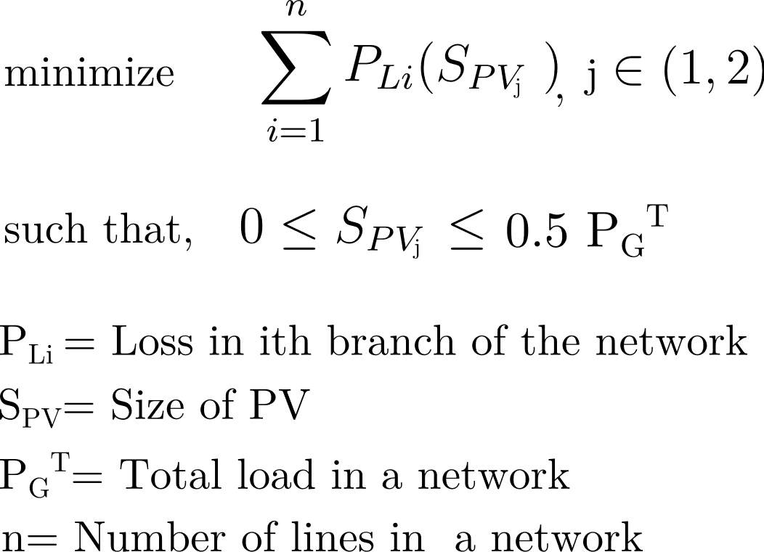
Objective Function and constraints

Slide 5
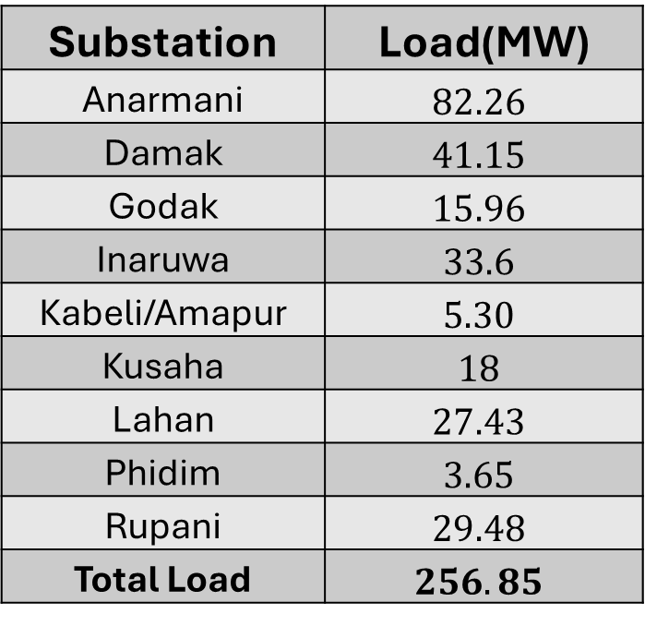


Finding constraints
Substation | Load(MW)
Anarmani | $$82.26$$
Damak | $$41.15$$
Godak | $$15.96$$
Inaruwa | $$33.6$$
Kabeli/Amapur | $$5.30$$
Kusaha | $$18$$
Lahan | $$27.43$$
Phidim | $$3.65$$
Rupani | $$29.48$$
Total Load | $$256.85$$
$$Max PV size =\frac{256.85}{2}=128.43 MW$$
$$Min PV size =0 MW$$

Slide 6
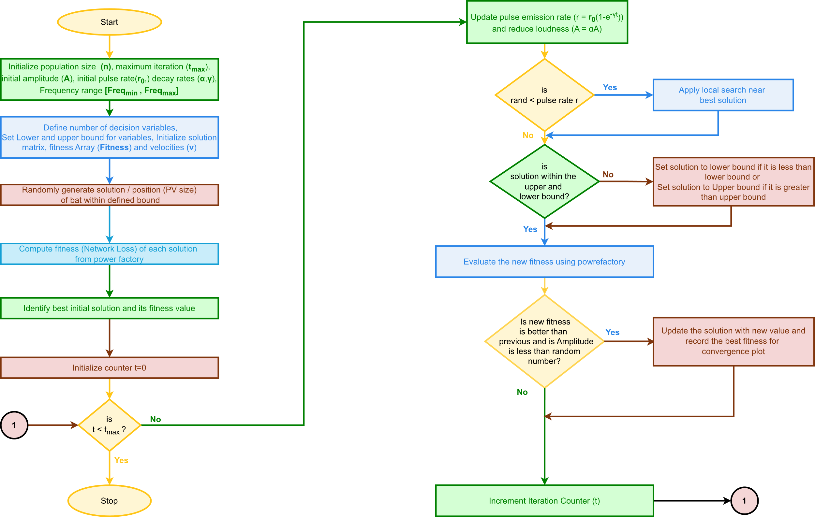
Flowchart for Bat Algorithm

Slide 7
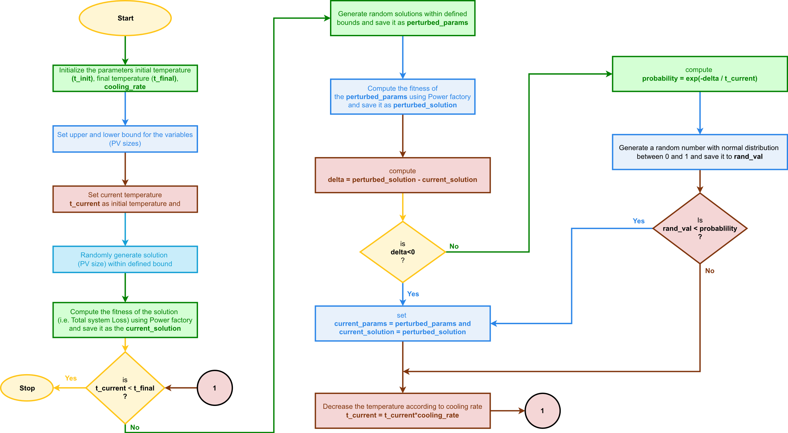
Flow Chart for Simulated Annealing

Slide 8
Parameters for Bat Algorithms
Parameters | Values
Population size (n) | 25
Maximum no. of Iteration (t_max = 50) | 50
Initial Loudnesss (A) | 100 dB
Initial Pulse Rate (r_{o}) | 100
Pulse emission rate (alpha) | 0.95
Loudness reduction rate (gamma ) | 0.1
Minimum Frequency | 0 Hz
Freq_max = 100; | 100 Hz

Slide 9
Parameters for Simulated Annealing
Parameters | Values
Initial Temperature | 0.1
Final Temperature | 061112
Cooling rate | 0.99

Slide 10
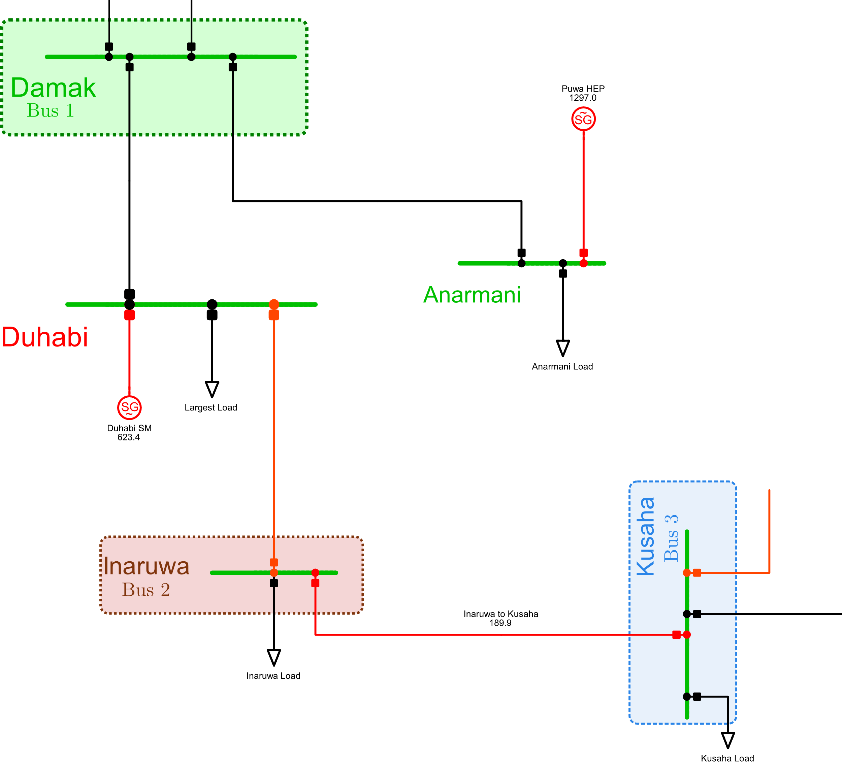
Finding Optimum Location of PV
BAT Algorithm
PV Location | System Loss (Bat) (kW) | Optimum PV Sizes in kW
Bus 1 and Bus 2 | 19.32 | [21506 ,12386]
Bus 1 and Bus 3 | 17.6 | [22710,18652]
Bus 2 and Bus 3 | 20.81 | [13982 , 21871]
SA Algorithm
PV Location | System Loss (SA) (kW) | Optimum PV Sizes in kW
Bus 1 and Bus 2 | 19.14 | [22642 , 22709]
Bus 1 and Bus 3 | 17.61 | [22524,18095]
Bus 2 and Bus 3 | 20.74 | [14864, 22673]
Bus ̄1 and Bus 3 is found to be the optimum Location

Slide 15
Comparison between BAT and SA
S.N. | Comparison Parameters | BAT | SA
1 | Mean Value of convergence | 17.33 kW | 17.61 kW
2 | Standard deviation | 0.3618 kW | 0.2625 kW
3 | Optimal buses | Anarmani and Kusaha | Anarmani and Kusaha
4 | Optimal Sizes (MW) | 20835 kW, 19997 kW | 19838 kW, 22409 kW
5 | Loss after optimal PV placement at optimal location | 17.33 kW | 17.6 1 kW
6 | Average time for convergence | 5 minutes | 44 seconds

Slide 16
Conclusion
The optimum size and location of PV is determined by using
Bat algorithm and
Simulated Annelation (SA)
Convergence speed of SA is much faster than that of Bat Algorithm but shows slightly more standard deviation.
The speed of convergence and accuracy depends on how we choose the initial parameters.

Slide 17

Annex 1: Simulation File
All Simulation Files

Slide 18
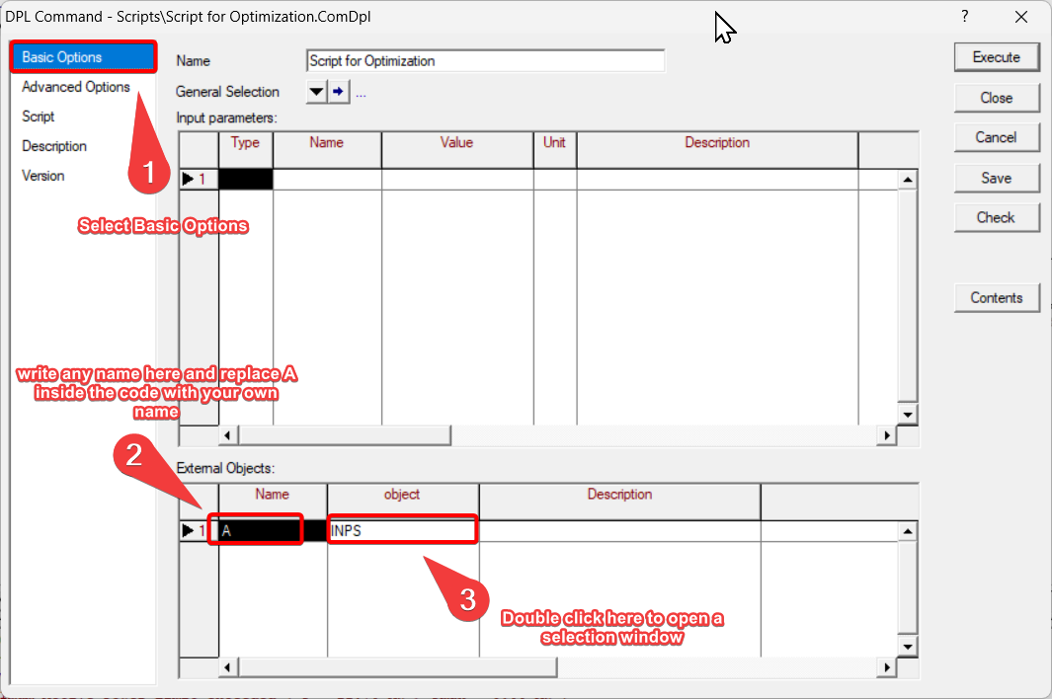
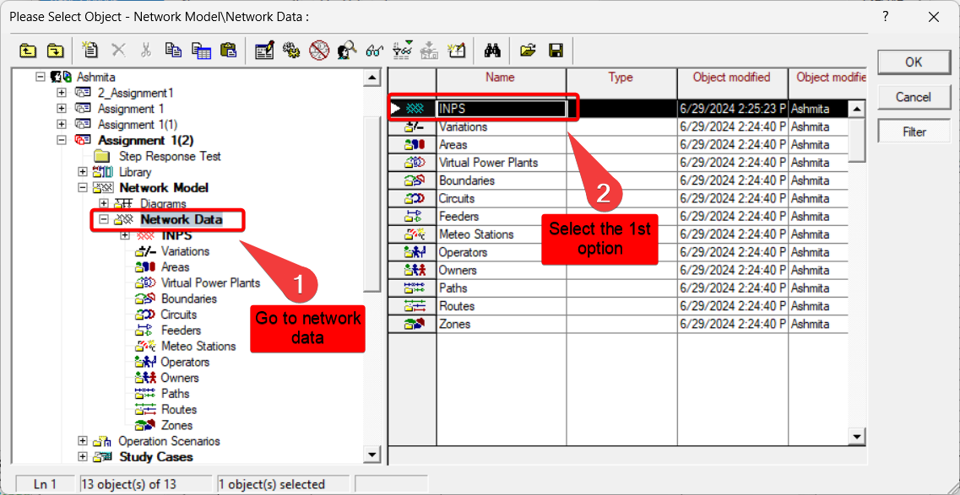
Annex 2: Power factory setup

Slide 19
Annex 3: Temperature of SA

